Slide 1
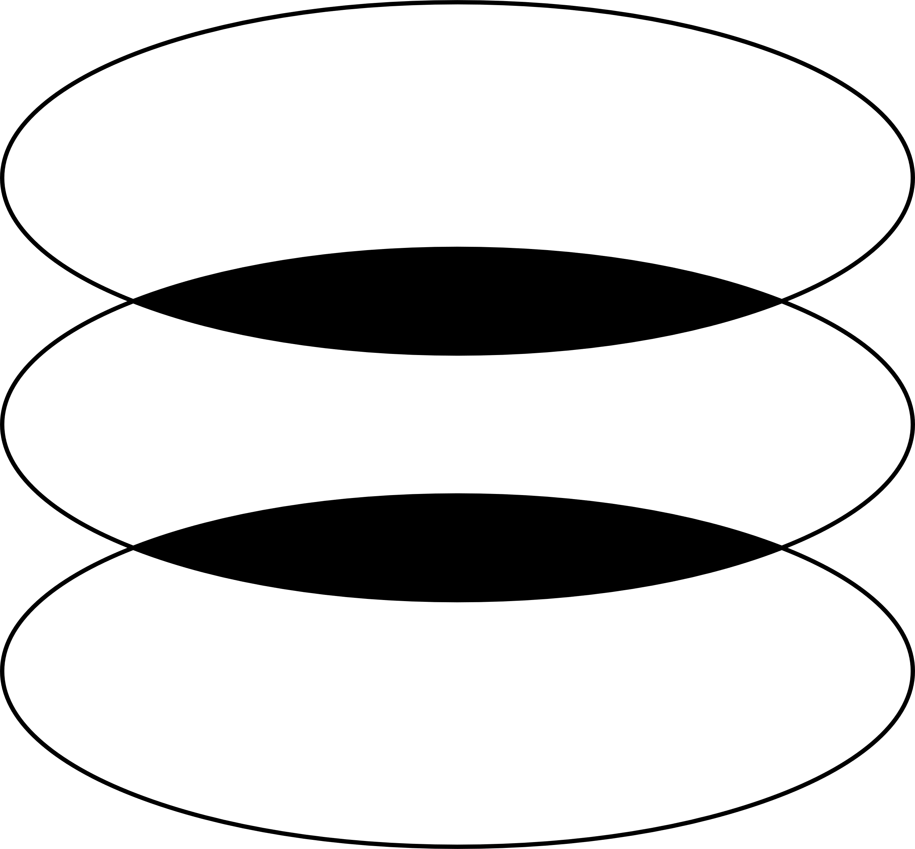

A Stellar Renaissance: Exploring the Star Formation of Spiral Galaxy, NGC 3344
Naomi Carl
Dr. Sanchayeeta Borthakur
Dr. Rolf Jansen
Arizona Space Grant Consortium

Slide 2
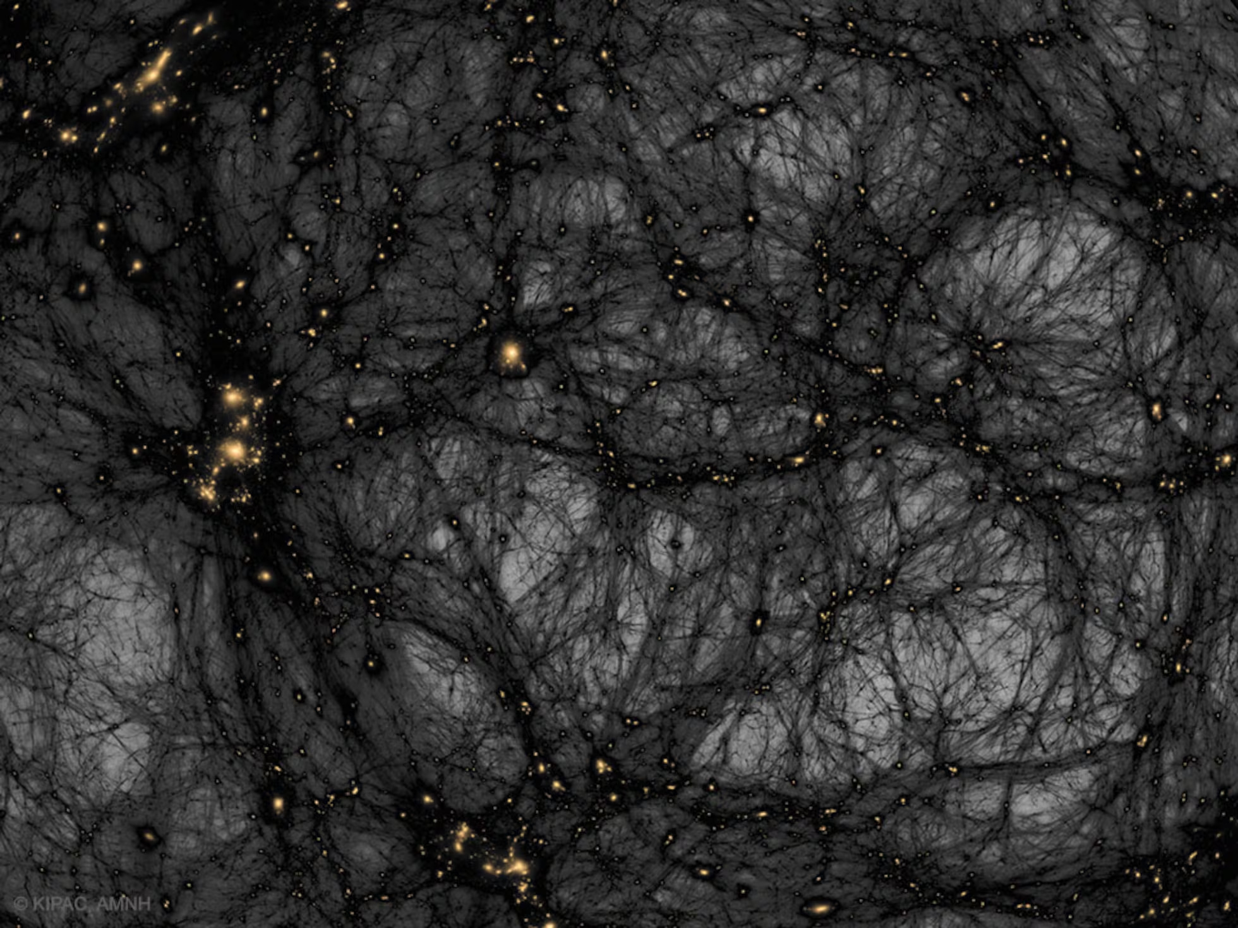
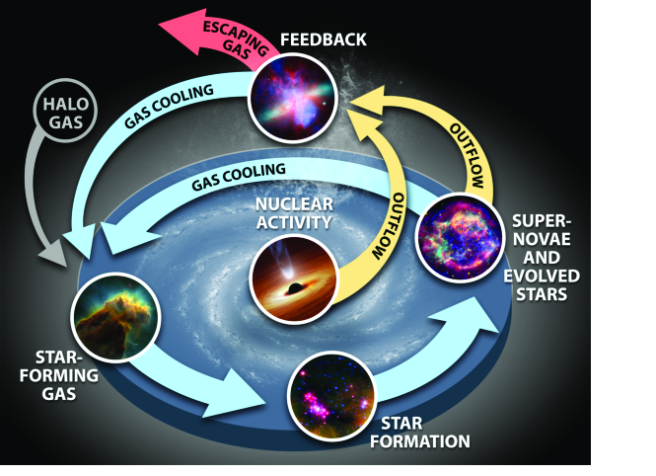
Star Formation & Galaxy Evolution
Stars, Gas, and Dust fuel galaxy formation and evolution.
These elements flow through the Baryon Cycle, in which gas reservoirs drive star formation, growing the galaxy and its dust.
(Leisawitz et al. 2019)

Slide 3
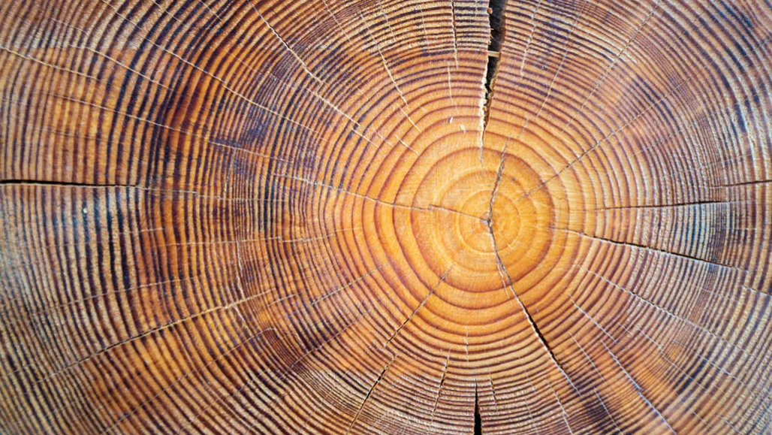
Inside-Out Growth
Galaxies grow from the inside-out, increasing in size as they grow more massive (Barden et al. 2005). This means we expect to see the oldest stellar populations in the center of the galaxy, since the outermost disc is newly formed.

Slide 4
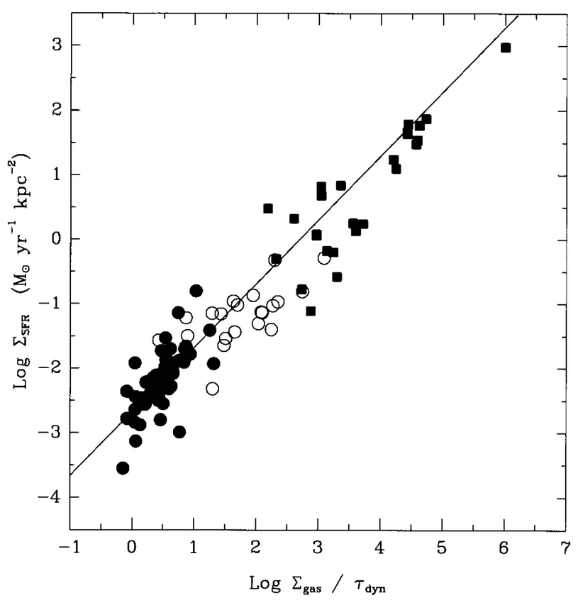
The Kennicutt-Schmidt Law
The Kennicutt-Schmidt Law shows us that the Star Formation Rate (SFR) of a galaxy is directly tied to the density of gas (Kennicutt, 1998b).
With this in mind, we expect to see a decrease in star formation in the outskirts of a galaxy, where the gas is less dense.
(Kennicutt 1998)

Slide 5
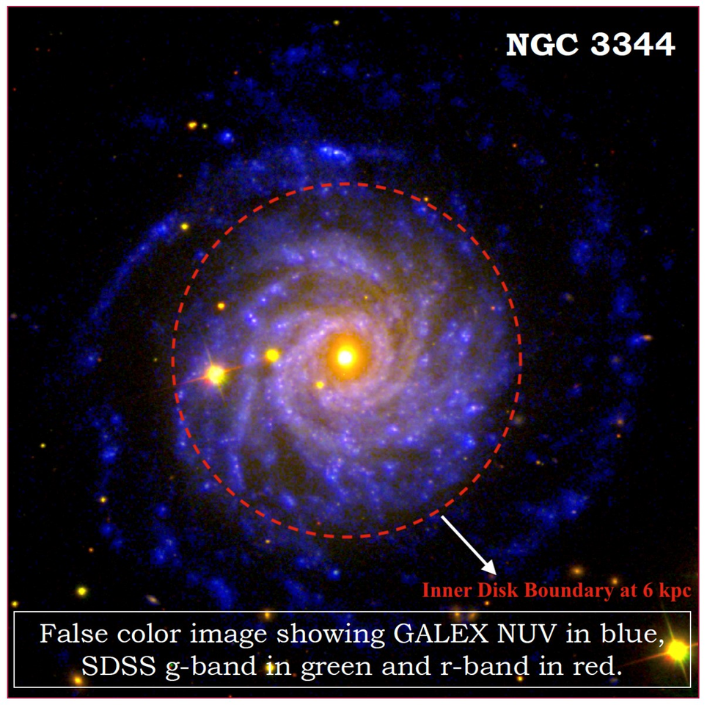
NGC 3344 & XUV Discs
Nearby, face-on, spiral galaxy, approximately 20 million light years away (Sabbi et al. 2018)
NGC 3344 is an exciting case study, as the galaxy is actively forming stars in its outer disc, where low density allows us to detect individual stellar clusters (Padave et al. 2021).
This is characteristic of an XUV disc, which has low gas density but high star formation, and is disconnected from the main disc.
(Padave et al. 2021)

Slide 6
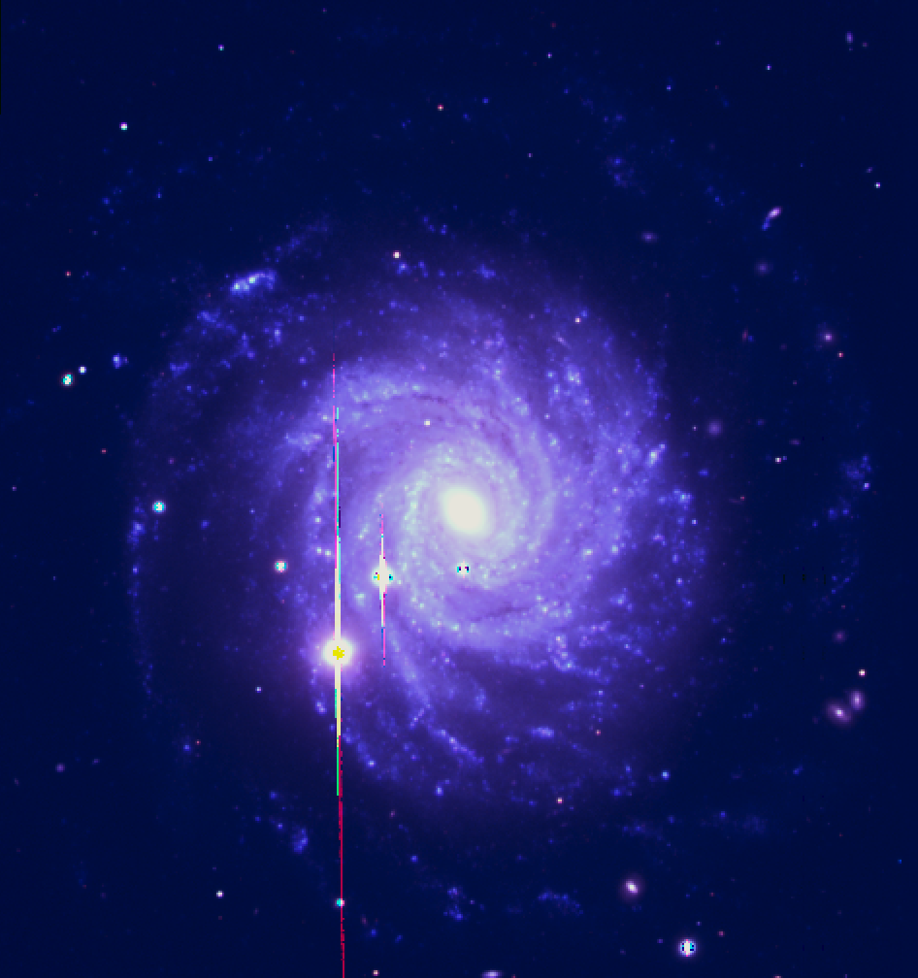
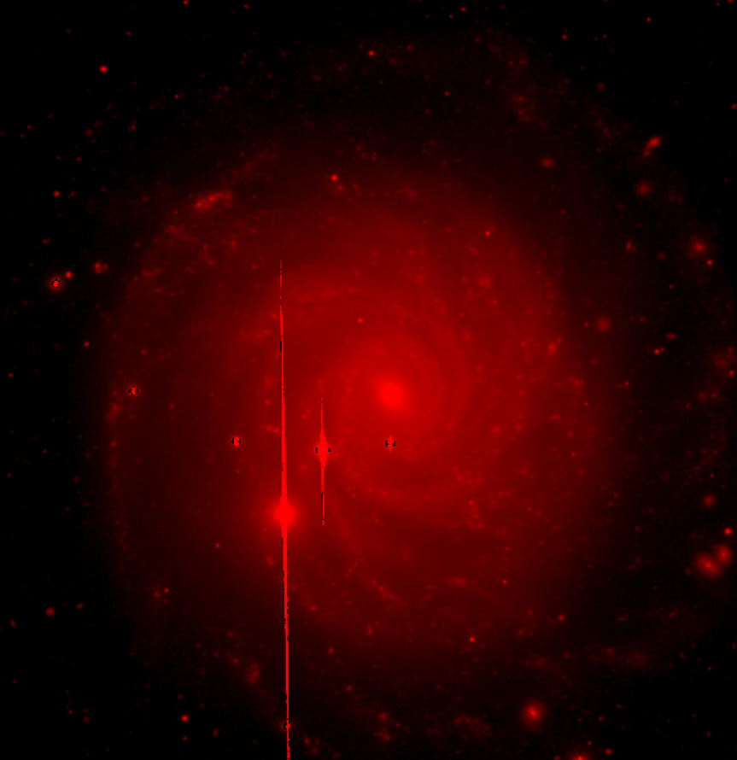
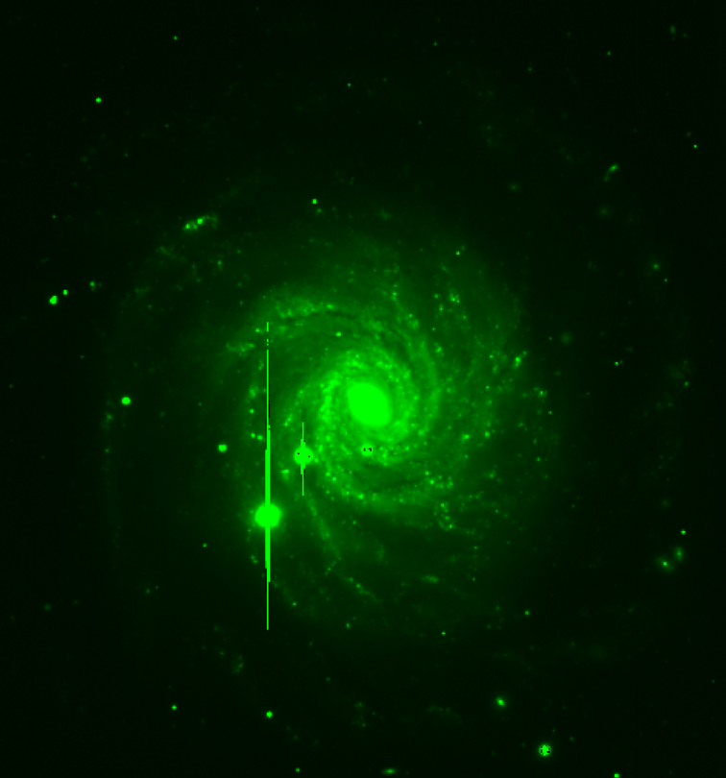
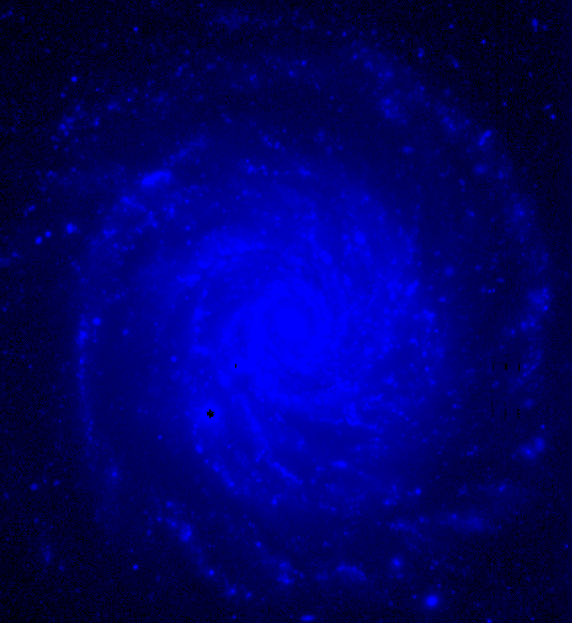
Our observations are taken with the Large Binocular Telescope in Graham County, Arizona.
r-band
g-band
U-band

Slide 7
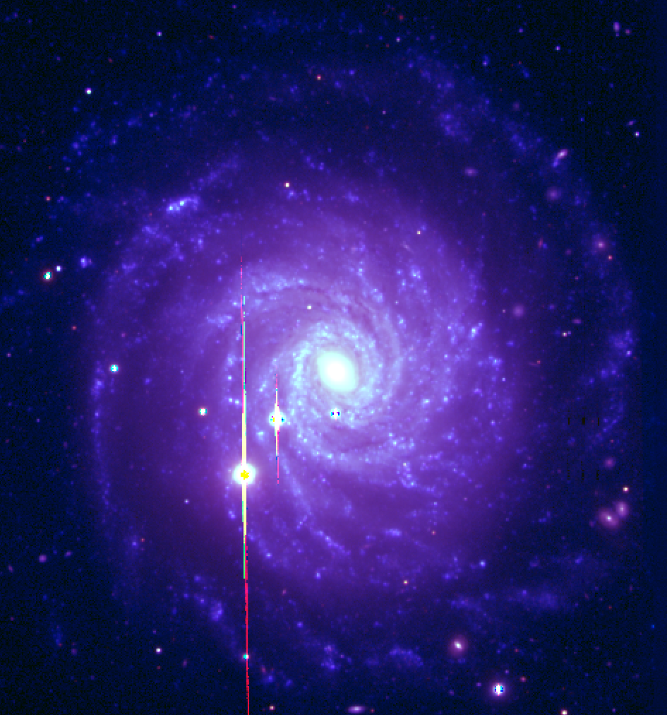
LBT (false color RGB)

Slide 8

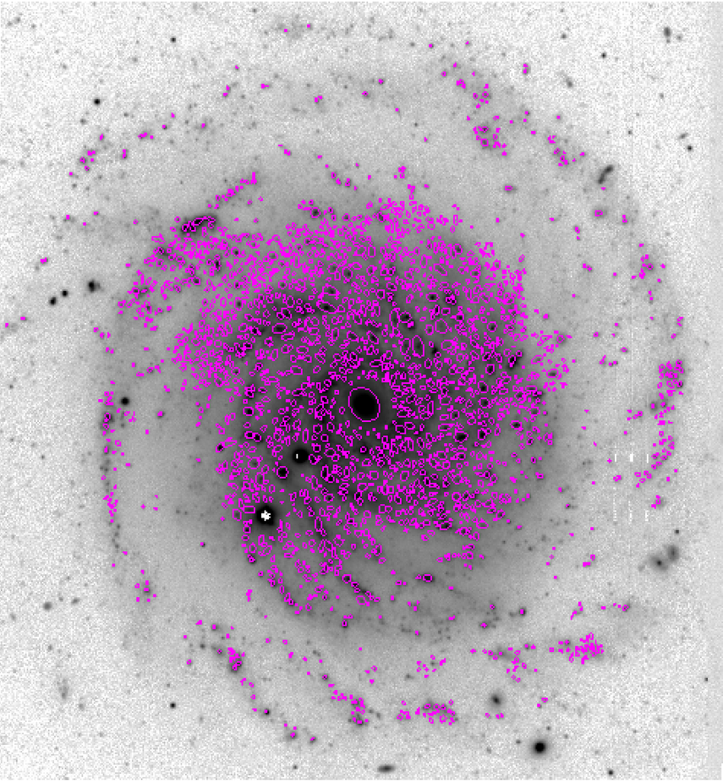
Source Identification
Using Source Extractor & Python, including Astropy & Photutils packages, we performed aperture photometry to fit the ellipses to each identified cluster. This allows us to measure the flux in each individual source.
We then calculate the U-r color by subtracting the r-band fluxes from the U-band fluxes to approximate stellar age.

Slide 9
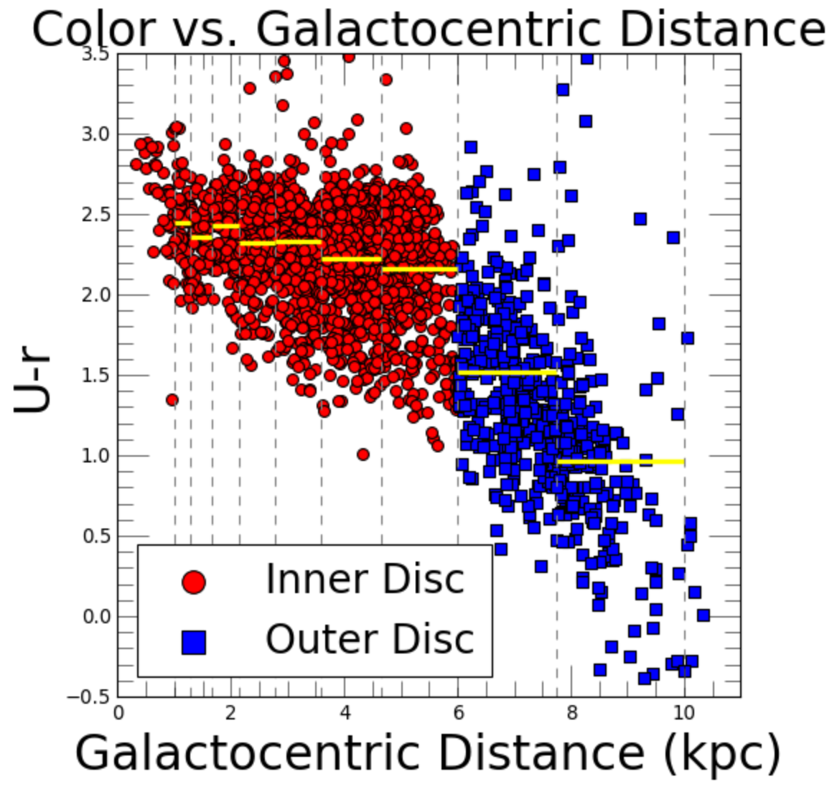
Color vs. Distance
U-r color decreases as we get further from the center of the galaxy.
By geometrically binning the data, it becomes clear that the stellar clusters beyond 6 kpc are more disperse and appear to have a steeper slope.
We color clusters in the inner disc in red, and clusters in the outer disc in blue.

Slide 10
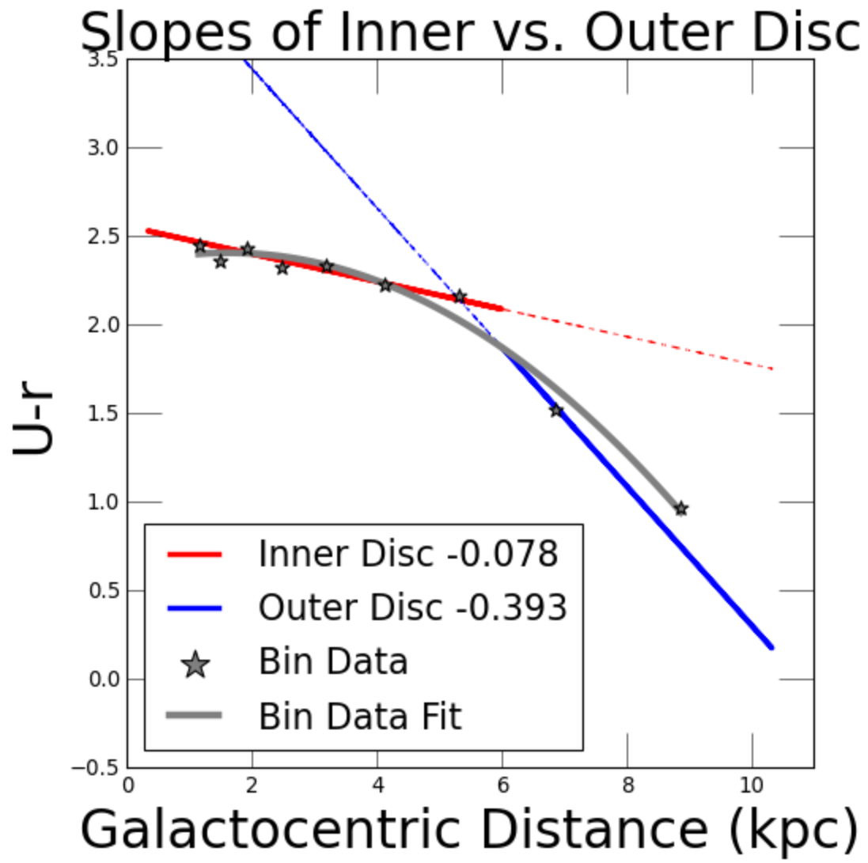
Inner & Outer Disc Slopes
When we plot slopes correlating to the inner and outer discs, we can confirm that the outer disc slope is approximately 5 times steeper than the inner disc.
We also plot the median points from the bins with a quadratic fit line. However, we can see that the slopes of the inner vs. outer disc are distinctly different fits.

Slide 11
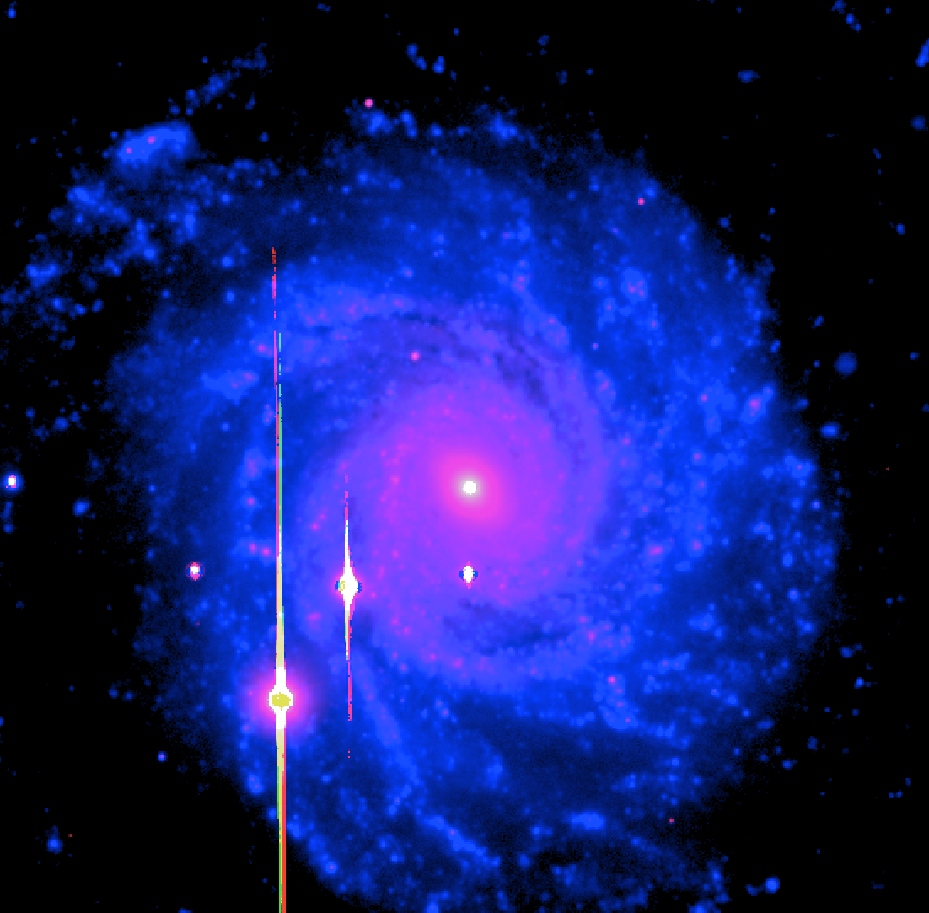
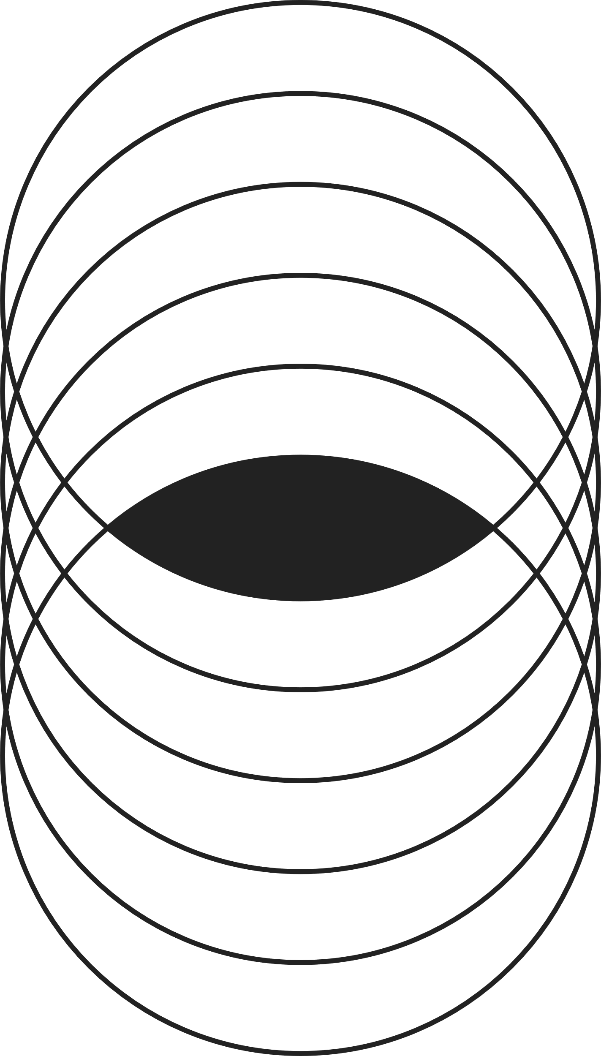
Conclusions
The outer disc of NGC 3344 is dominated by young stellar populations
NGC 3344 is growing in an inside-out formation pattern
What does this mean? To understand NGC 3344’s star formation history, we must analyze the inner and outer stellar populations as different objects!
In the future, we would like to run Spectral Energy Distribution (SED) models on NGC 3344's inner and outer disc separately, and determine the cause of the star-forming event for Padave et al. 2025 (in prep)

Slide 12


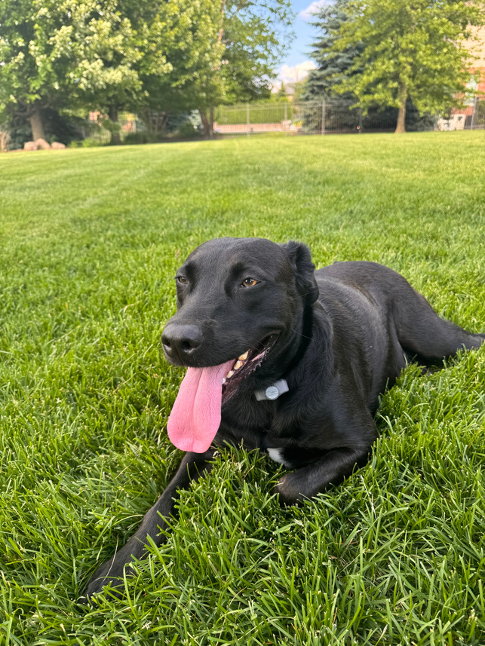

Acknowledgements
Dr. Sanchayeeta Borthakur & Dr. Rolf Jansen
Dr. Mansi Padave
STARs Lab
ASU/NASA Space Grant
Family & Friends :)

Slide 13

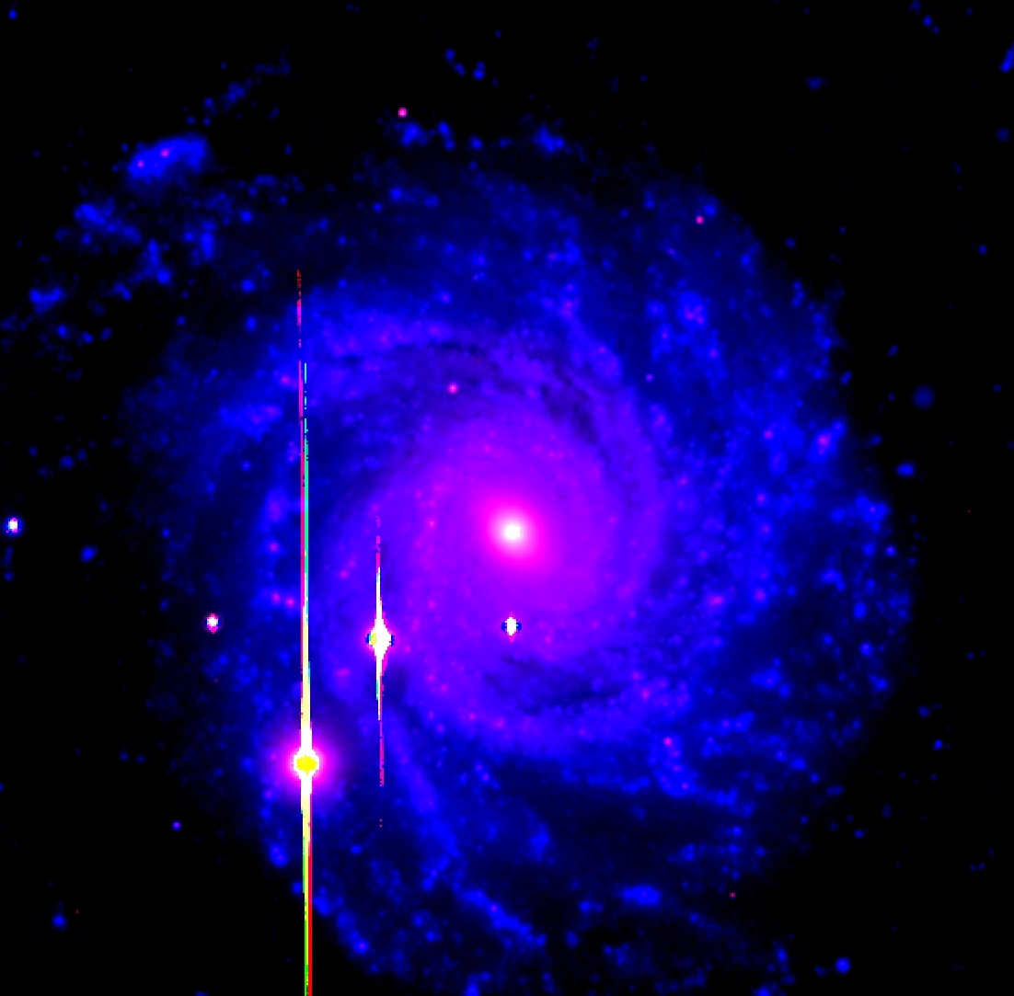
Questions?
contact me:
nfcarl@asu.edu
LinkedIn
thank you!

Slide 14
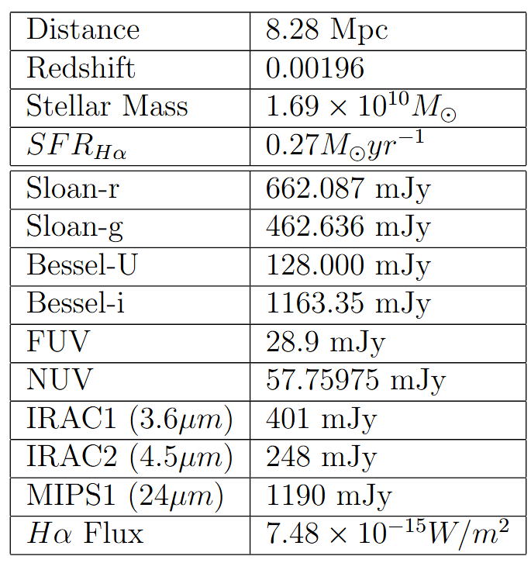


Ancillary Data
SED modeling requires observations from a wide range of wavelengths, beyond optical.
We source additional data from the NASA/IPAC Extragalactic Database (NED) to more accurately fit the model.
To supplement the infrared range, we uses the IRAC 3.6 micron band (Dale et al. 2009).
We also use Padave et al. 2021 for FUV and NUV fluxes, and to calculate the flux.

Slide 15
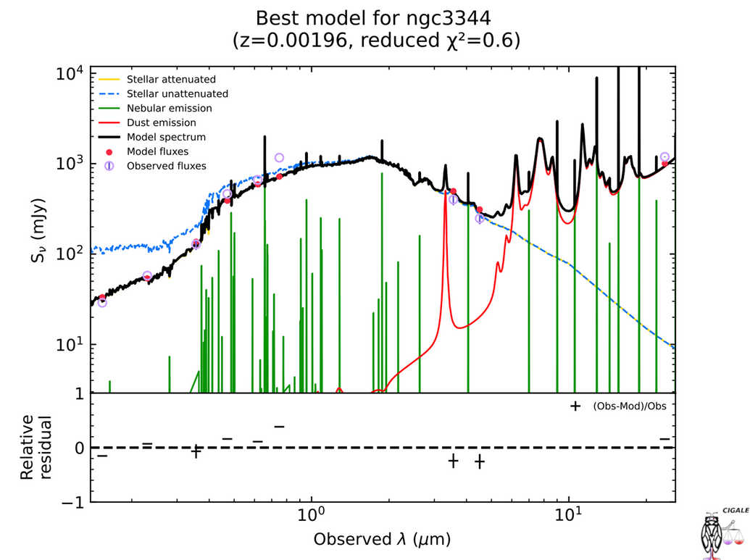
SED Modeling: Best Fit
With additional points added, this fit is slightly “less accurate,” but this makes sense, and the error is within reason still.
We find the delayed constant star formation & burst/quench model to be the best fit.
With less combinations for this SFH, CIGALE ran 1,469,664 models.

Slide 16
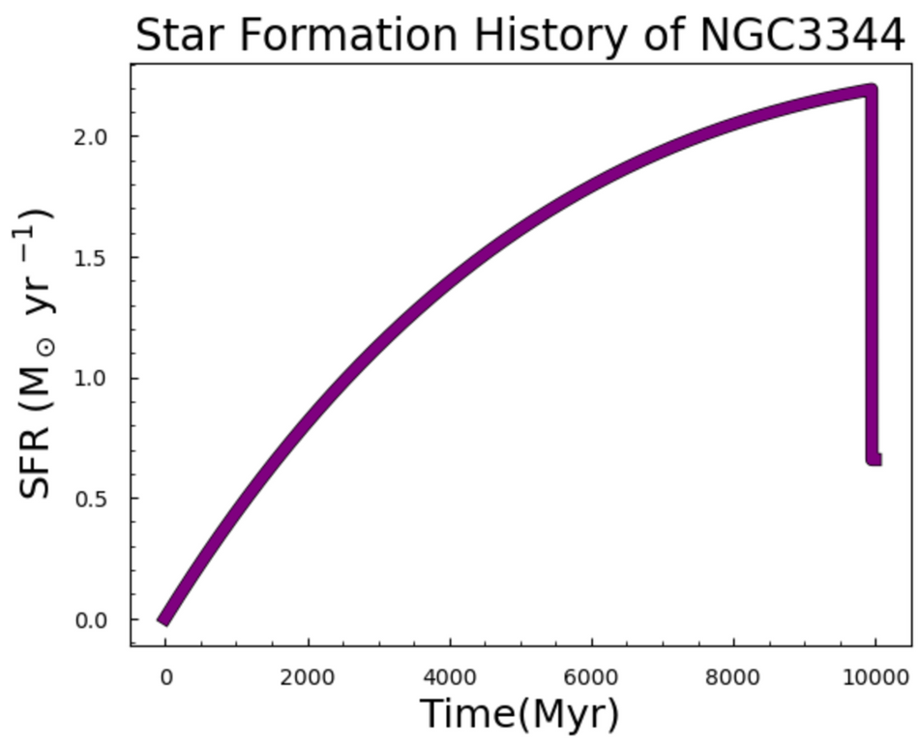
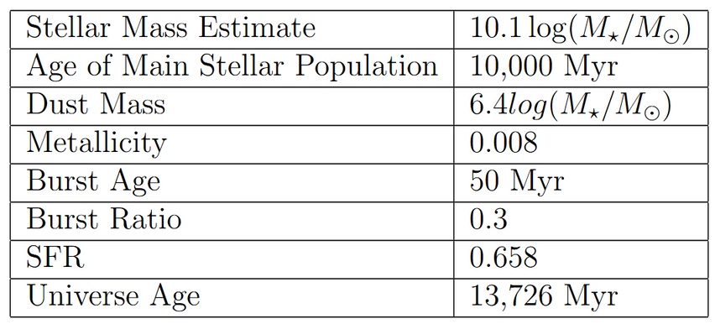
5. SFH: Best Model
This model has a reasonable SFR!
Furthermore, when we integrate the area under the curve, we find that it closely matches the stellar mass observed in Padave et al. 2021.
CIGALE also tells us that the galaxy had a constant burst event 50 Myr ago, which resulted in a 30% increase in the SFR.
Age (Myr)

Slide 17
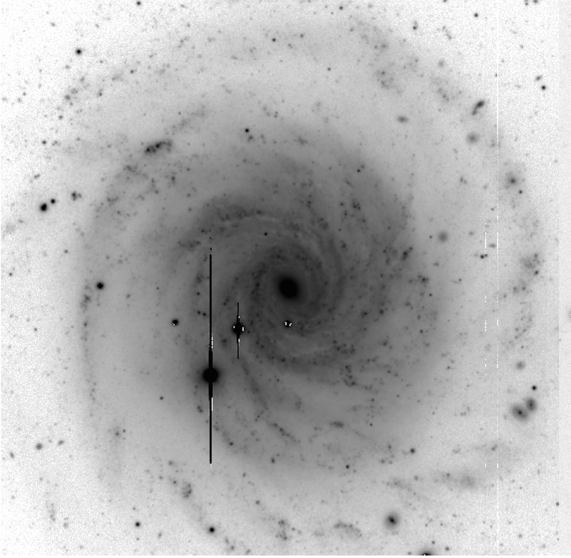
Data Reduction
Our original image from LBT had imperfections from “bad pixels,” dust on the mirror, and the sky.
We subtract the flats and biases provided from the LBT Observatory to account for this.
This sufficiently removed the large flaws from the image, but we still had some streaks of bad pixels that could not be removed. These pixels were removed from out photometric calculations, along with the large diffraction spikes in the foreground.
LBT (inverse black & white)

